Slide 1

Natural Language Processing Course Text Classification
Ivo Bernardo – Udemy Course

Slide 2

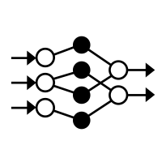


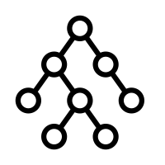
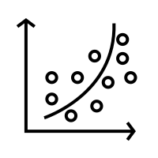
Text Classification – Machine Learning Models

Slide 3
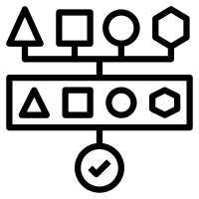

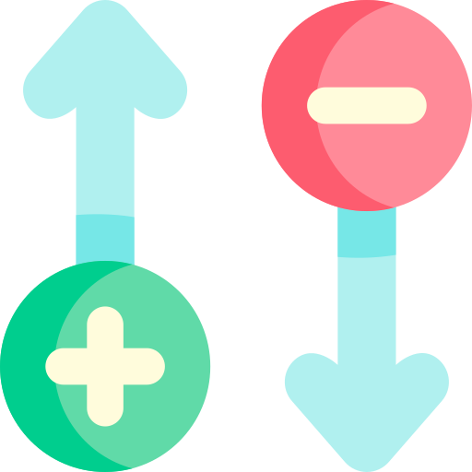
Text Classification – Pipeline
Lowercase Text;
Remove Stop Words;
Remove Punctuation;
Stemming or Lemmatization
BinaryVectorizer
CountVectorizer
TF-IDF

Slide 4
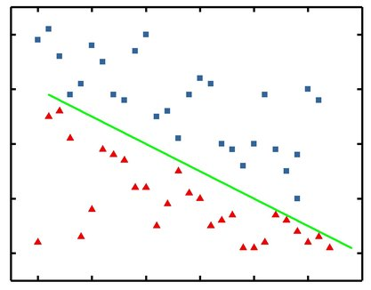
Text Classification – Pipeline
BinaryVectorizer
CountVectorizer
TF-IDF
https://www.researchgate.net/figure/Logistic-regression-and-linear-regression_fig1_335786324

Slide 5
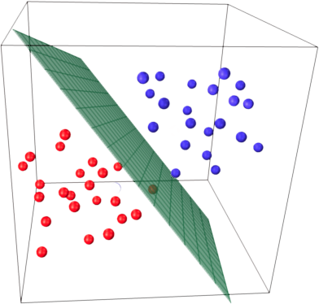
Text Classification – Logistic Regression
2 Dimensions
3-Dimensions
Plot 1 - https://www.researchgate.net/figure/Logistic-regression-and-linear-regression_fig1_335786324
Plot 2 - http://blog.sairahul.com/2014/01/linear-separability.html

Slide 6
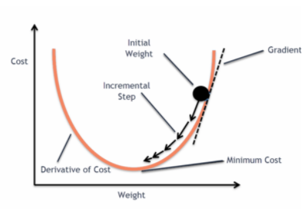
Text Classification – Gradient Descent
Error!
B0 + good*B1+bad*B2+... word-i*Bi
https://www.analyticsvidhya.com/blog/2020/11/binary-cross-entropy-aka-log-loss-the-cost-function-used-in-logistic-regression/

Slide 7
Text Classification – Matrix of Features
Good, bad, ..., word-i

Slide 8
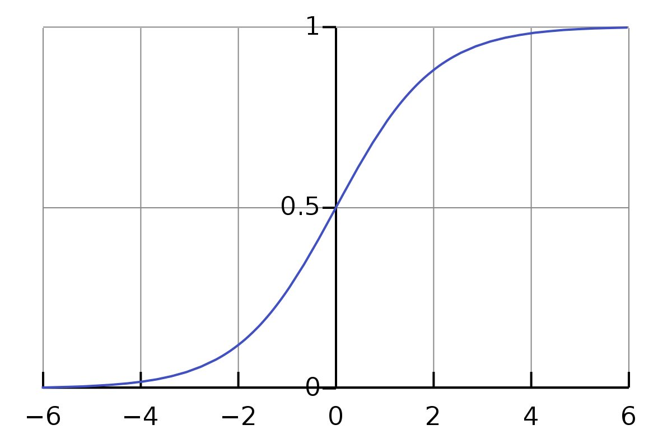

Text Classification – Sigmoid Function
Z = B0 + good*B1+bad*B2+... word-i*Bi
50%, 0.5
P(1) = $\frac{1}{1+e^{(−z)}}$

Slide 9



Text Classification – Training and Evaluating
$$β1 for word good$$
90% of Dataset
$$β2 for word bad$$
$$βi for word i$$
BinaryVectorizer
Train
CountVectorizer
Evaluating
TF-IDF
10% of Dataset

Slide 10
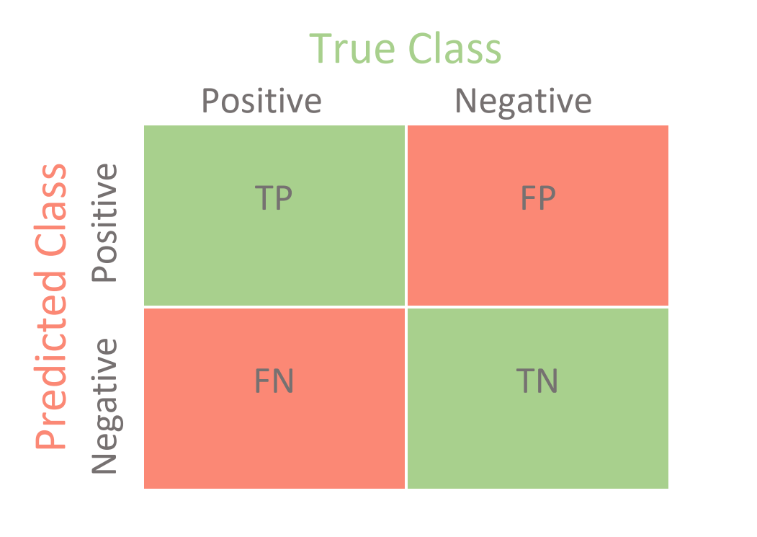
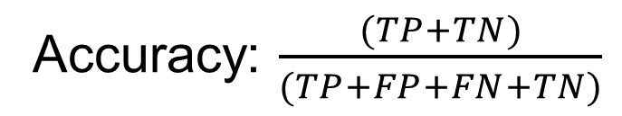
Text Classification – Confusion Matrix
Accuracy: $\frac{(TP+TN)}{(TP+FP+FN+TN)}$
TP = True Positives, sentiment is positive and we flagged it correctly
FP = False Positives, sentiment is negative and we flagged it incorrectly
TN = True Negatives, sentiment is negative and we flagged it correctly
FN = False Positives, sentiment is positive and we flagged it incorrectly
https://towardsdatascience.com/confusion-matrix-for-your-multi-class-machine-learning-model-ff9aa3bf7826

Slide 11

Text Classification – Classifying New Text

Slide 12
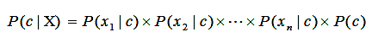
Text Classification – Other Models – Naive Bayes Classifier

Slide 13
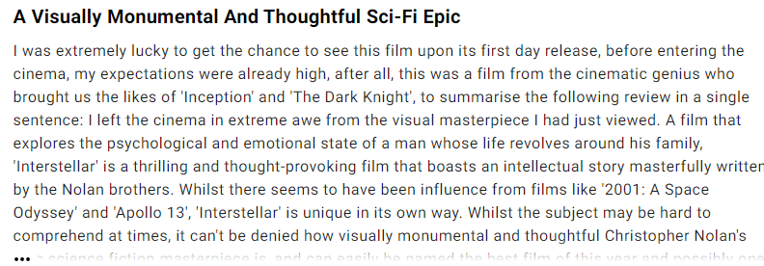
Ultimate Goal of Every Machine Learning Model
70% probability
30% probability

